Slide 1

McGraw-Hill Technology Education
Copyright © 2006 by The McGraw-Hill Companies, Inc. All rights reserved.

Slide 2
Chapter 10B
Doing Business in the Online World

Slide 3
Consumer E-Commerce
Online shopping
  Purchasing through a web site
  Also called Business to Consumer (B2C)
  List of products is nearly endless
  Features
    Searchable catalog
    Secure checkout
    Customer support page

Slide 4
Consumer E-Commerce
Online stores versus brick and mortar
  Brick and mortar implies a physical store
  Brick and mortar properties
    Limited hours
    Salespeople can offer assistance
    Customers can handle the merchandise
  Online store properties
    Store is open 24 x 7
    Salespeople usually not available
    Can only view the merchandise

Slide 5
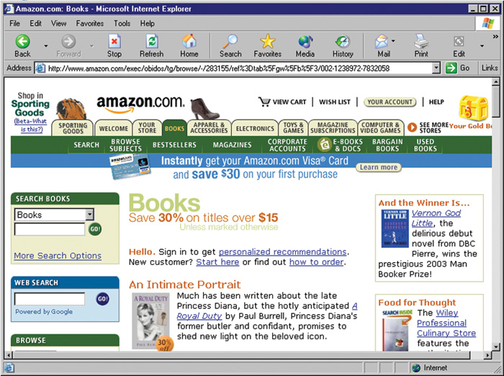
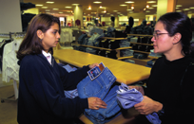
Online vs. Brick and Mortar
Online store catalog
Brick and mortar store experience

Slide 6
Consumer E-Commerce
Using online catalogs
  Good online stores have a catalog
  Products are often arranged by category
  Products can be found by keyword
Notes:
Teaching tip
Open an online store in class and demonstrate exactly how the catalog works.

Slide 7
Consumer E-Commerce
Paying for purchases
  Vendors accept several payment methods
    Credit cards
    Paypal
    Electronic Fund Transfer
  May need to create an account
    Simplifies shipping
    Encourages repeat shopping
Notes:
Insider information
Suggest to your students that they use the same account name and password for every online vendor they visit. This will simplify their lives when the revisit the site in the future.

Slide 8
Consumer E-Commerce
Getting customer service
  Needed to resolve problems
  Understand the policies before ordering
  Contact information
    How you contact the vendor
  Return policies
    Availability and fee for returning items
  Shipping policies
  Charges and fees
    Convenience fees

Slide 9
Consumer E-Commerce
Online banking
  Most teller services handled online
  Balances can be obtained
  Bills can be paid
  Access is typically very secure
  Not available at all banks

Slide 10
Consumer E-Commerce
Online finance
  Broker and investment services
  Costs less than a traditional broker
  Stocks and bonds can be traded
  Loans can be procured
  Tax returns can be filed

Slide 11
Business E-Commerce
Business to business (B2B)
  Business transaction between companies
  Accounts for the majority of e-commerce
  Initially private networks were used
  Common transactions
    Reorder inventory
    Purchase stocks
    Credit checks

Slide 12
Business E-Commerce
Intranets and extranets
  Business partners must work together
    Networks must work together
  Intranet uses Internet technologies
    Only internal workers can access resources
    Use a standard browser to access resources
  Extranets open the Intranet to clients
    Clients have password level access
    Allows the same abilities as employees
  Very simple to use and setup
Notes:
Insider information
Very large businesses may force smaller clients to conform to their network. Two examples are Ford and Highmark Insurance. In Highmark’s case, they require doctors accepting their insurance to process bills using Highmark’s software.

Slide 13

Business E-Commerce
Telecommuters
  Employee working outside of the office
  Connects to the office through technology
  Several technologies are used
    Home computer and the Internet
    Key card changes passwords often
    Encryption is used to protect data
Notes:
Discussion point
Have students list the pros of telecommuting. Expect answers like: “working in my underwear” and “no need to commute”. Once several pros have been listed, switch to cons. Introduce the problems of promotions, employee isolation, and extremely long work days. Finish with the problem of outsourcing to different countries.

Slide 14
Security
Improved security measures
  Before 1998, Web security was nonexistent
  Now safer than restaurant purchases
  All reputable sites protect their customers

Slide 15
Security
Secure web pages
  Allows safe transmission of credit card
  Use the secure socket layer (SSL)
    Encrypts data transmission to the server
  Secure pages are easily identified
    URL uses https://
    Browser status bar shows a closed lock
Notes:
Teaching tip
Explain to your students that Internet security is a very tough concept. The information presented in the chapter is simply a brief introduction. An excellent tutorial on web security can be found on www.pdweb101.com/.

Slide 16
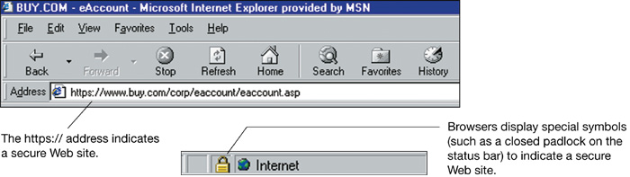
Secure pages

Slide 17
Chapter 10B
End of Chapter

